Slide 1



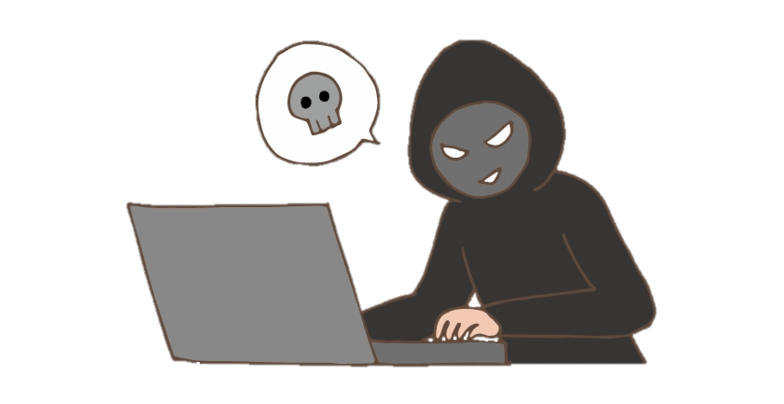
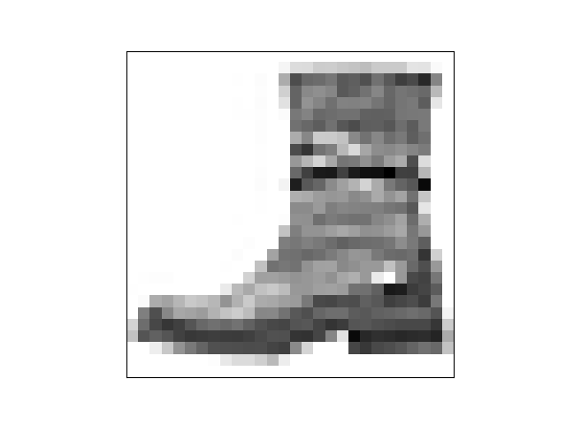
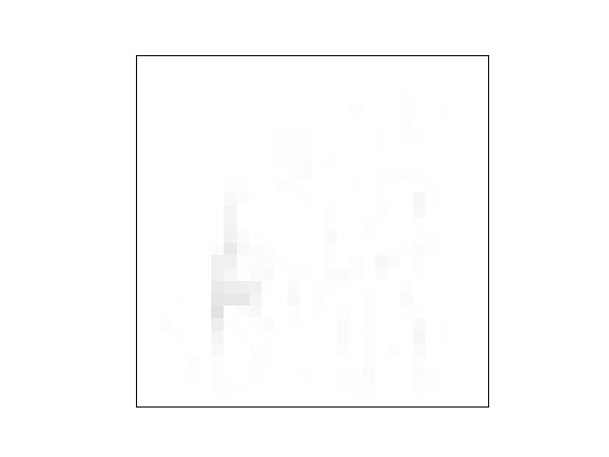

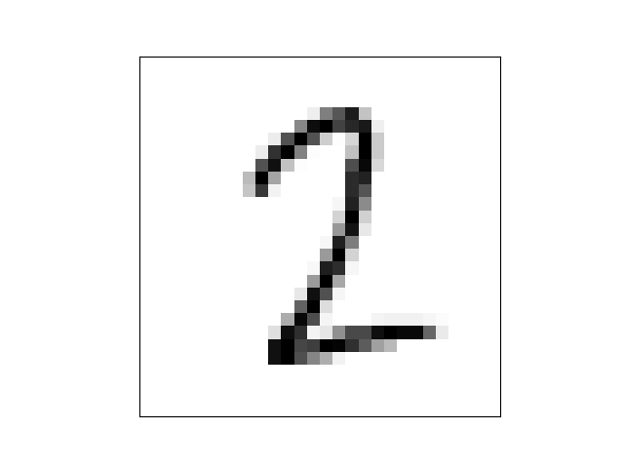
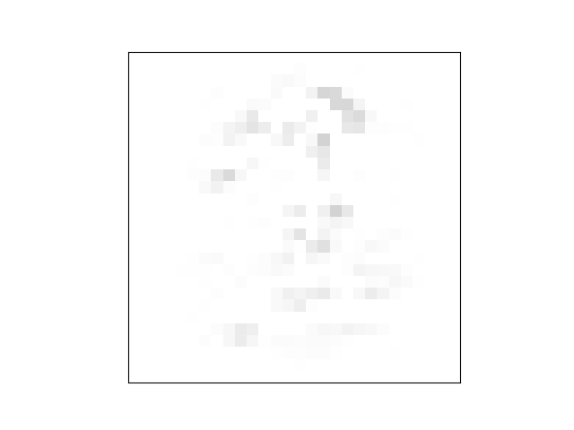
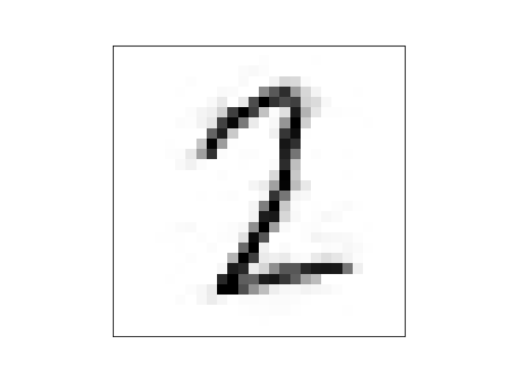




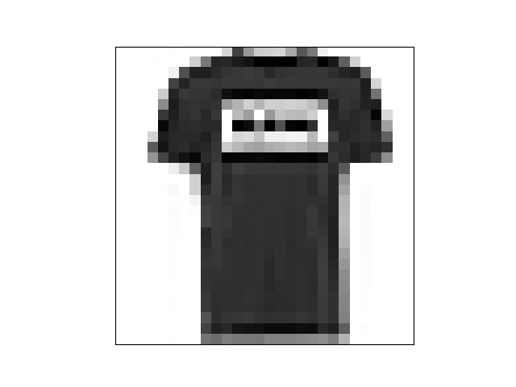

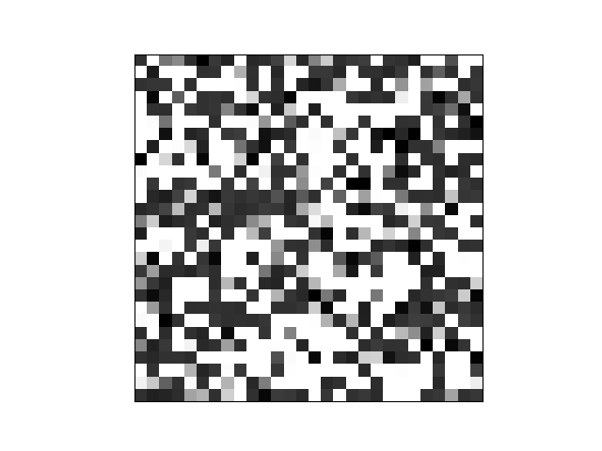
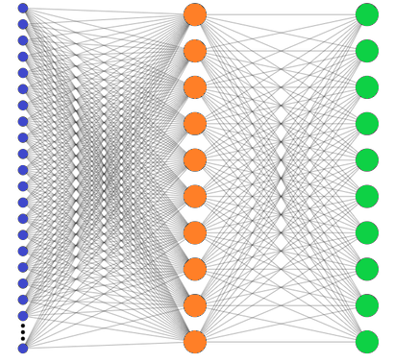


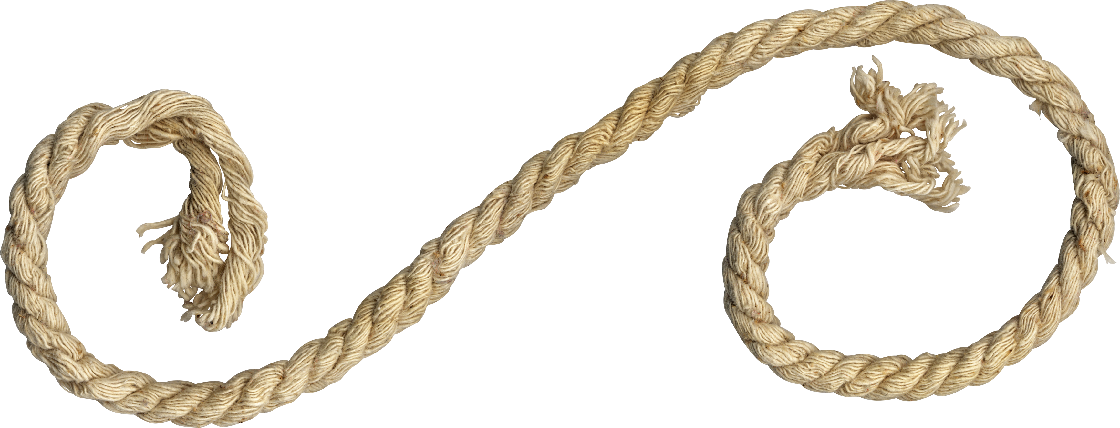
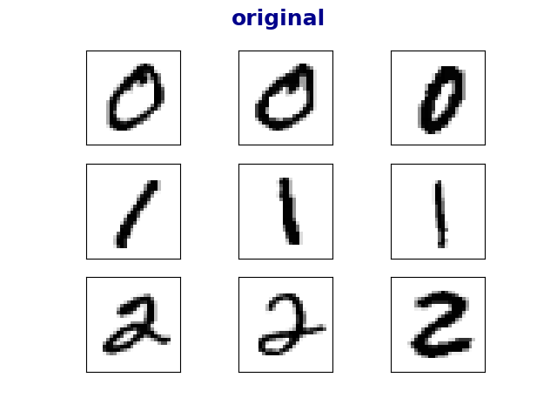
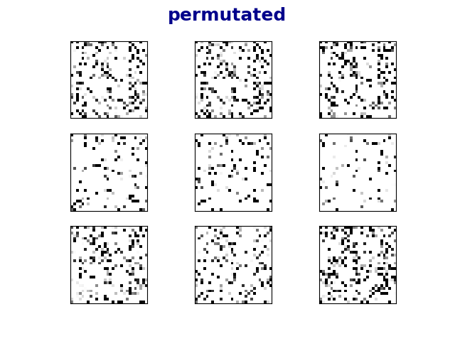
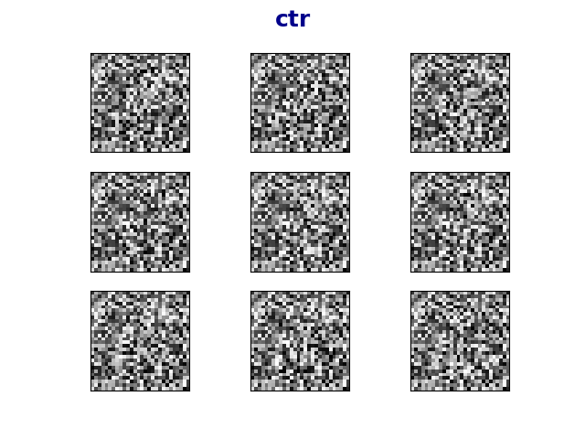




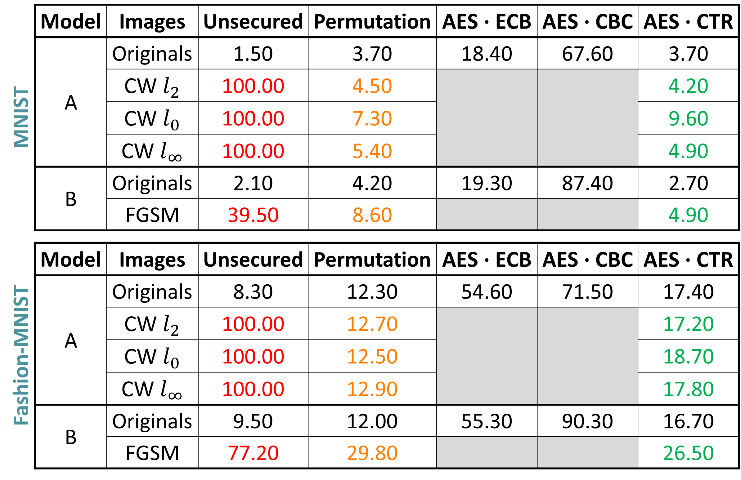
בס"ד
DEFENSE AGAINST
ADVERSARIAL EXAMPLES
­­­­­­­­­___________________
Yishay Asher • Steve Gutfreund
Supervisor: Hanan Rosemarin
Problem Description
Building high accuracy DNN models which are sufficiently resistant to adversarial attacks
Background and Goal
4
0
Attacking
An adversarial example is an instance with small, intentional feature perturbations that causes a machine learning model to make a false prediction.
The goal is to find a way to train ‘secured’ models such that these sort of attacks should not affect them.
Project based on the article Bridging machine learning and cryptography in defense against adversarial attacks.
Attacks:
Carlini & Wagner, CW
Fast Gradient Sign Method, FGSM
‘gray-box’ scenario, i.e. the attacker knows the architecture of the model but has no access to the private key (nor the weights).
original
noise
adversarial
original
noise
adversarial
+
=
+
=
unsecured: 100% it’s “ankle boot”
secured: 95% it’s “ankle boot”
unsecured: 52% it’s “sandal”
secured: 73% it’s “ankle boot”
100% it’s “two”
49% it’s “one”
visualization of a CW attack secured by AES ∙ CTR
example of an adversarial image
Results
1
5
Set-Up
We achieved the goal with models applying permutation and
AES ∙ CTR encryption techniques on the images. Full results below.
MNIST and Fashion-MNIST datasets
Using well-known neural nets
Training ‘unsecured’ models
MNIST | Model | Images | Unsecured | Permutation | AES ∙ ECB | AES ∙ CBC | AES ∙ CTR
 | A | Originals | 1.50 | 3.70 | 18.40 | 67.60 | 3.70
 |  | CW $l_{2}$ | 100.00 | 4.50 |  |  | 4.20
 |  | CW $l_{0}$ | 100.00 | 7.30 |  |  | 9.60
 |  | CW $l_{∞}$ | 100.00 | 5.40 |  |  | 4.90
 | B | Originals | 2.10 | 4.20 | 19.30 | 87.40 | 2.70
 |  | FGSM | 39.50 | 8.60 |  |  | 4.90
Fashion-MNIST | Model | Images | Unsecured | Permutation | AES ∙ ECB | AES ∙ CBC | AES ∙ CTR
 | A | Originals | 8.30 | 12.30 | 54.60 | 71.50 | 17.40
 |  | CW $l_{2}$ | 100.00 | 12.70 |  |  | 17.20
 |  | CW $l_{0}$ | 100.00 | 12.50 |  |  | 18.70
 |  | CW $l_{∞}$ | 100.00 | 12.90 |  |  | 17.80
 | B | Originals | 9.50 | 12.00 | 55.30 | 90.30 | 16.70
 |  | FGSM | 77.20 | 29.80 |  |  | 26.50
2
Securing Models
Approach: training models on encrypted images.
Encryption techniques:
Permutation
AES in ECB, CBC and CTR modes
T-shirt
architecture for securing models
6
classification error (%) on the first 1000 test samples
Cutting Loose Ends
Success with Permutation , Coincidence?
3
To verify that the learning ability of a permutation model does not result from high density in small images, we trained models on padded images.
We eliminated the models that did not learn well.
Learning encrypted images is not very intuitive, as can seen below.
original
permutated
ctr
 | image size | error rate
MNIST | 28x28 | 3.70
 | 40x40 | 3.40
 | 60x60 | 3.30
Fashion- MNIST | 28x28 | 12.30
 | 40x40 | 14.40
 | 60x60 | 10.80
sample of the encrypted images.
results for training permutated data, various image dimensions
Future Work
 | Improve accuracy on AES-ECB model |  | Nicholas Carlini (‘C’ in CW) believes that CW might still defeat these defenses |  | Test on more complicated datasets; i.e. Cifar-10

